Slide 1

Introduction to Electronic Health Records
Ann E Bancroft, BSN RN

Slide 2
Objectives
Identify the legal beginnings of EHR
Identify the impacts of the EHR upon nursing
Recognize the EHR as an inter-professional communication tool
Recognize electronic charting as an evolving, ever-changing medium requiring continuous adaptation

Slide 3
A Little History
Affordable Care Act:
“implement activities to improve patient safety and reduce medical errors through the appropriate use of best clinical practices, evidence based medicine, and health information technology” (ACA, 2009. p. 31).

Slide 4
A Little More History…
American Recovery and Reinvestment Act of 2009
Improve quality, safety, and efficiency of patient care
Engage patients and families
Improve coordination of care
Ensure privacy and security of personal health information
Improve population and public health (Wilson and Newhouse, 2012. p. 396)

Slide 5
Impact on Nursing
Documentation of patient outcomes
Improving nursing work flow
Evidence-based practice
Support nursing assessments and interventions
Improved inter-professional communication

Slide 6
Benefits of EHRs
Immediate access to health care records
Improved interdisciplinary communication
Improved efficiency
Improved quality of care

Slide 7
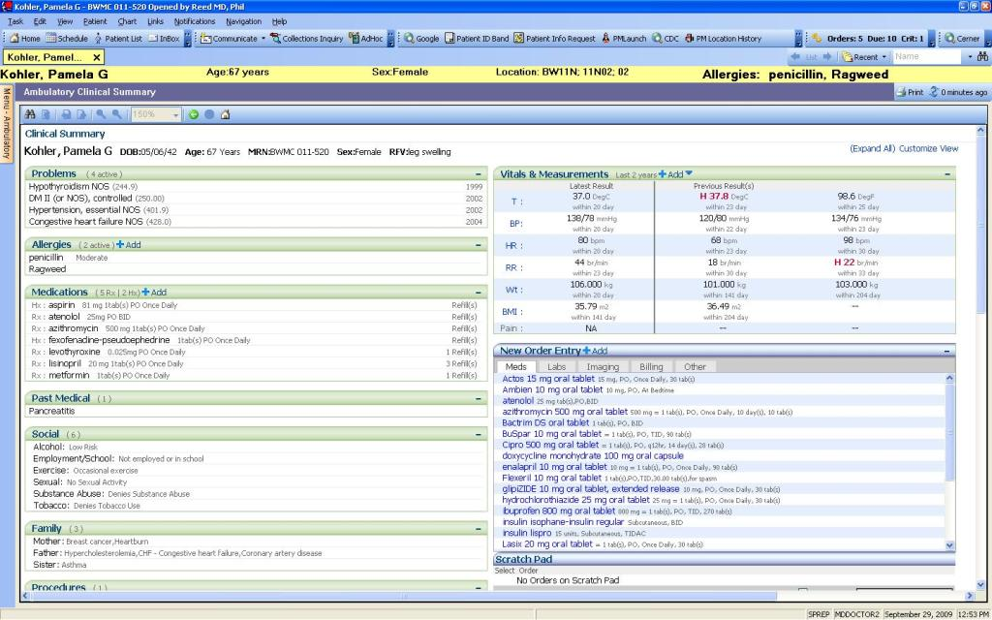
A Quick Glance

Slide 8
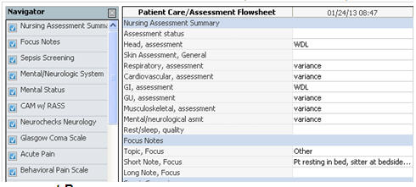
Nursing Assessment

Slide 9
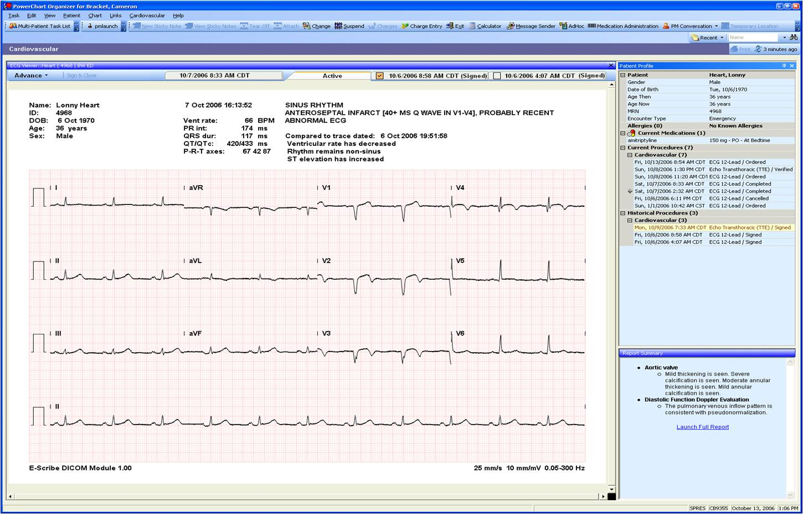
Diagnostic Results

Slide 10
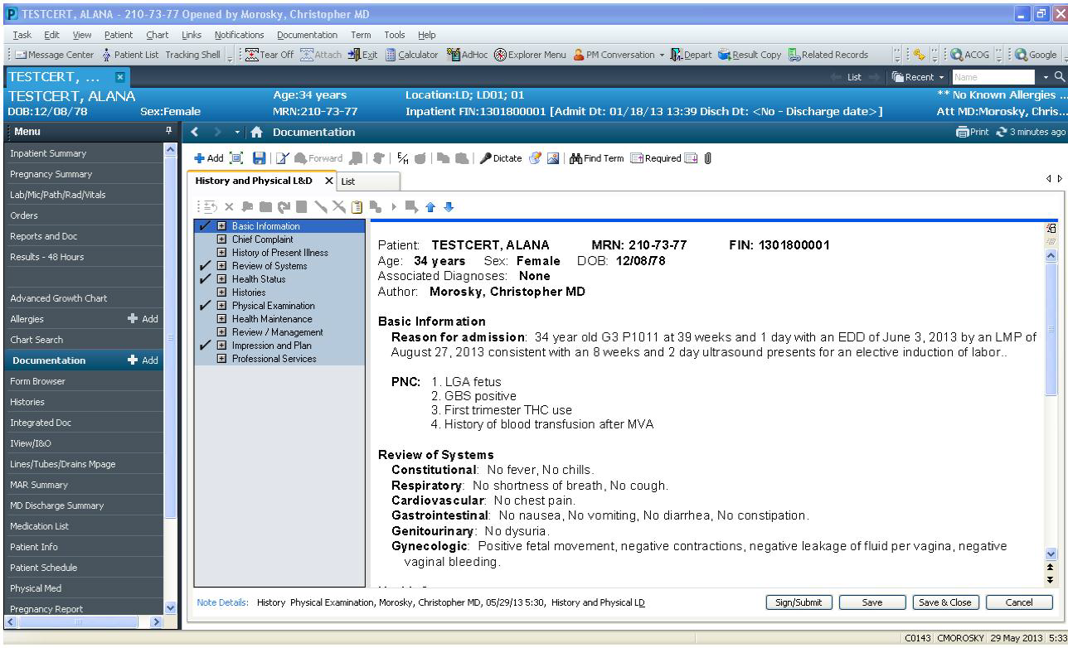
History and Physical

Slide 11
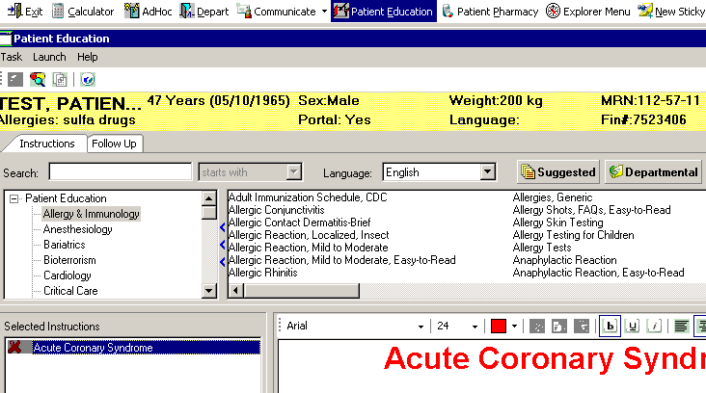
Patient Education

Slide 12
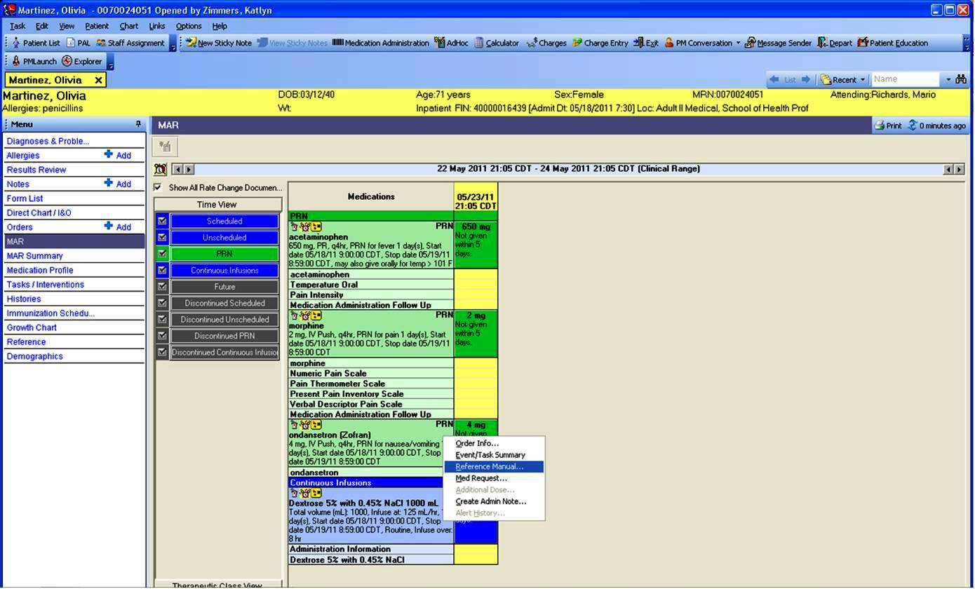
Medication Administration Record

Slide 13

Into the new world…

Slide 14
References
Baille, L., Chadwick, S., Mann, R., & Brooke-Read, M. (2012). A survey of student nurses’ and midwives’ experiences of learning to use electronic health record systems in practice. Nurse Education in Practice. 13, 5. 437-441. Retrieved from http://dx.doi.org/10.1016/j.nepr.2012.10.003
Bolla, Y. (2011). Meaningful Use 101. Nursing Management. 42, (2). 18-22. doi: 10.1097/01.NUMA.0000399803.14328.72
Dimick, C. (2009). Defining "Meaningful Use" in ARRA. Journal of AHIMA. Retrieved from http://journal.ahima.org/2009/04/29/defining-meaningful-use-in-arra/
H.R. 3590--111th Congress: Patient Protection and Affordable Care Act. (2009). Retrieved February 6, 2013, from http://www.govtrack.us/congress/bills/111/hr3590.
Wilson, M. L. & Newhouse, R. P. (2012). Meaningful use: Intersections with evidence-based
practice and outcomes. Journal of Nursing Administration. 42, (9). 395-398. doi:
10.1097/NNA.0b013e3182668162

