Slide 1
Communication tlo 1.6
Ann E Bancroft

Slide 2
COMMUNICATION from inside out
INTRAPERSONAL
Internal dialogue
Constructive or Positive
Negative
INTERPERSONAL
Assessment
Teaching
Explaining care
Comfort
GROUP
Meetings
Education
Group therapy
Family teaching
PUBLIC
How much interaction from and with the group?

Slide 3
COMMUNICATION from inside out
GROUP (TWO OR MORE)
MEETINGS
GROUP THERAPY
INTERPERSONAL (ONE ON ONE)
ASSESSMENT
TEACHING
INTRAPERSONAL (INTERNAL)
CONSTRUCTIVE
NEGATIVE
EXPLAINING CARE
COMFORT
EDUCATION
FAMILY TEACHING

Slide 4
ELEMENTS OF COMMUNICATION
Sender: Encoding message, decoding reply, providing (encoding) clarification, decoding feedback
Verbal, inflection, tone, emphasis, word choice, connotation, timing, clarity, brevity, volume
Receiver: Decoding message, encoding reply, seeking clarification, providing feedback
Nonverbal, facial expression, posture: open or closed, gestures, touch, personal appearance

Slide 5
confidentiality
Creates and maintains TRUST in the health care process, health care provider relationships, and one on one rapport.
Allows patient to maintain CONTROL of their health care information.
The trust and control of personal information allows the continuing and improving COMMUNICATION.
STATEMENT OF ANA POSITION:
The American Nurses Association (ANA) believes that protection of privacy and confidentiality is essential to maintaining the trusting relationship between health care providers and patients and integral to professional practice (ANA, 2015a). ANA supports legislation, policies and standards that protect individually identifiable health information.
American Nurses Association, 2015. Privacy and confidentiality. Retrieved from http://www.nursingworld.org/DocumentVault/Position-Statements/Ethics-and-Human-Rights/Position-Statement-Privacy-and-Confidentiality.pdf

Slide 6
Cultural influences
Language barriers: how do we get around the wall?
Face to face interpreters
Phone interpreters
Skype interpreters
Do we use family or friends for interpreting?
HIPAA!
Does the family or friend understand medical terms and are they translating them correctly?
How do you know?
Family as translators is not best practice
Explore cultural preferences:
How would you care to be addressed?
Is there someone you would like to be present for this conversation/process/procedure?
Eye contact? Personal space?
How can I convey respect?

Slide 7
Communication across the life span
Infants and toddlers: combine simple verbal with non-verbal communication
Preschoolers: more verbal, keep verbal communication simple and direct, use gestures to help the child focus
School age children: Increased comfort and confidence in verbal communication, explore level of understanding and vocabulary as well as preferred method of learning
Older adults: Explore possible sensory deficits that may impede communication, changes in memory or cognition, and the ability to use non-verbal communication (facial droop from stroke may impede facial expressions)

Slide 8
Patient-nurse interview: building the framework
Establish and maintain rapport and trust
Gather information needed for interview
Communicate caring, ask questions, seek clarification
Assist or allow patient to express concerns, thoughts, feelings
Summarize and conclude
Assure patient of confidentiality again
Assure patient of confidentiality
Ensure privacy
Clarify information provided
Explore cultural inhibitors and preferences
Make sure you hear and understand what the patient is communicating
Sum up, explain next steps, conclude

Slide 9
Impaired communication
Hearing impaired: Does the patient use sign language? Would they like a sign interpreter? Are hearing aids used? Are they functional? Would written communication be effective? If it is partial hearing loss, reduce ambient noise, reduce distractions, face patient directly, use gestures as appropriate, enunciate clearly, slow your speech.
Speech impaired: Use of non-verbal communication, picture boards, family to aid in understanding, be patient and positive, do not assume patient cannot understand you just because they cannot say they do!
Visually impaired: Introduce yourself immediately upon entering room, use your patient’s name to verify you are addressing him/her, describe processes, sequences, placement of objects, furniture, any activity. Tell the patient that you are leaving and when you expect to return.

Slide 10
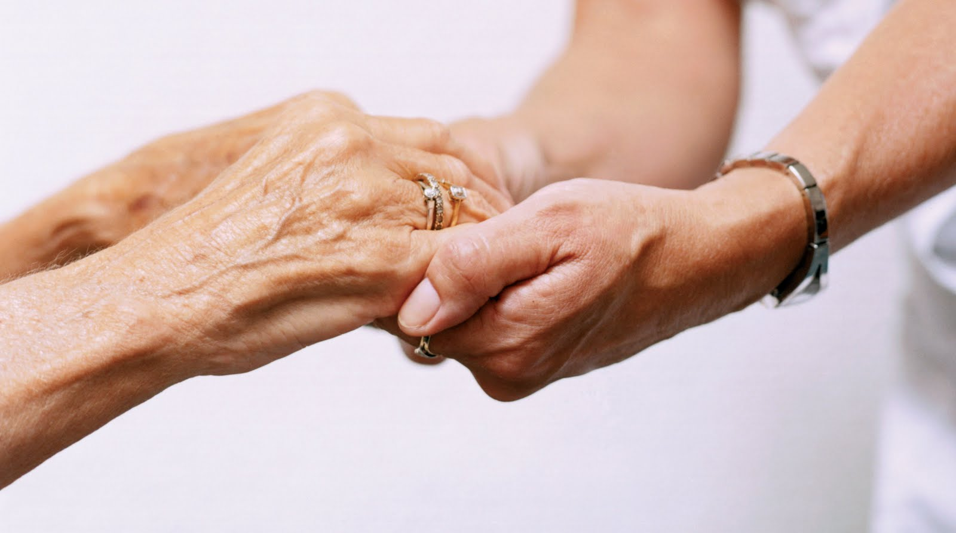
Impaired communication
Cognitively impaired: Always communicate, don’t rush the patient, use short sentences, be specific, use gestures to reinforce communication, use reminders for the patient, pay close attention to non-verbal communication, be patient!
Decreased level of consciousness: Touch and speak to the patient, introduce yourself and address the patient by name, explain what you are doing, what you are seeing, speak calmly. We are still not certain who hears what and when, so treat all patients as if they can hear you.

Slide 11
Subjective versus objective information
subjective
objective
Communicated:
My head hurts.
Patient states she is safe in home.
I take my medications regularly.
Observed or measured:
Patient has eyes closed, is holding head in hands.
Patient hesitates before answering questions, glances frequently at significant other, sits forward with hands clenched in lap. Bruises are evident on forearms and left jaw line.
Patient regularly refills prescriptions at expected intervals.

Slide 12
techniques
Think about examples of:
Active listening
Sharing observations
Sharing empathy
Sharing hope
Sharing humor
Sharing feelings
Using touch
Using Silence
9. Providing information
10. Clarifying
11. Focusing
12. Paraphrasing
13. Asking relevant questions
14. Summarizing
15. Self-disclosure
16. Confrontation

Slide 13
Self-disclosure
Communicating a subjective true experience about yourself to emphasize the similarities and/or differences. This technique is used sparingly and with caution, but in the manner of genuineness and empathy. Remember, the patient is the focus of the communication process.
“That happened to me once, too. It was devastating, and I had to face some things about myself that I didn’t like. I went to counseling and it really helped…..what are your thoughts about seeing a counselor?”

Slide 14
confrontation
This is a process of communication that helps clarify inconsistent messages from the patient. This is a delicate process and should be used after trust and rapport have been established. Approach gently, without accusation.
“You have stated several times that you want to quit smoking, and yet you are still struggling with this. What might be stopping you?”
Also be aware that you may be confronted if your messages are conflicting or unclear! Acknowledge it gracefully and clarify.

Slide 15
Decision making & prioritization TLO 3.3a
Ann E Bancroft

Slide 16
Is your patient breathing and pumping blood?
Prioritize Care:
Is there trouble?
Is it potentially life threatening?
Are there safety issues?
Could the safety issues lead to injury?
Is there pain/discomfort?
Is anything interfering with patient progress?

Slide 17
Help! 30 second evaluation
Help! First look the patient: are they breathing? Do they appear in pain? Are they pale? Gasping?
Environment & Equipment: Safety: is the room safe for the patient? Are there barriers to ambulation? Is there liquid spills? Is the equipment all working?
Look more closely: skin color, breathing pattern, dressings intact, odors, linens tangled, soiled, or missing
People in room: Who is present? Family, friends, clergy, caregivers? What are they doing?

Slide 18
Maslow’s hierarchy of needs
Self actualization
Aesthetic
Self esteem
Love and belonging
Safety
Physiological
Cognitive
Transcendence
Spiritual distress
Social isolation
Risk for impaired attachment
Risk for falls
Impaired gas exchange
Impaired memory

Slide 19
Planning and organizing
Report received
Meet patient(s), get vital signs
Prepare patient for breakfast, if applicable. (What will this entail? How much time will this take?)
Assist patient(s) with ADLs as needed. (Again, think of time likely to be expended)
Complete procedures that need to be done (multiple tasks? What equipment or supplies will you need? Do you understand the processes? Will you need support or assistance?)
Communicate! Communicate with your instructor, with your lead nurse, with your CNA, with any member of the team that needs to be aware of your actions or concerns.

Slide 20
Time management
Organize your thoughts, your day
Prioritize tasks
Estimate time for each task
Assume it will take longer than you expect
Assume that interruptions or delays are probable
As you grow in the role, learn what you need to delegate, what you can delegate, and what will take a team approach
Communicate! Ask for help, delegate tasks, communicate your plan to the instructor, the nurse, the CNA… And communicate if things do not go according to plan!

Slide 21
Scope of practice
The nurse is responsible for the nursing process:
Assessment (Getting the picture)
Nursing diagnosis (Your prioritization will come from these)
Planning: Interventions and outcomes (Your time management)
Intervention (Dive in!)
Evaluation (How did your actions, education, communication impact the patient?)

Slide 22
Ask yourself this…
What can you delegate?
What can be delegated to you?
As a first semester student nurse, can you give medications without your instructor?
Where are your resources?
What resources will you need?
What will you do if you have a question?
What will you do if someone asks you a question and you do not know the answer?

Slide 23
Monkey wrenches
What can disrupt the best laid plans?
Equipment issues
Missing supplies
Critical patient
Patient more complicated than initially thought
Patient family needs
Any unanticipated event

Slide 24
Teaching TLO 3.4a
Ann E Bancroft

Slide 25
Patient education
What is learning?
A change! In knowledge, behavior, skills, or attitude
What is teaching?
INTERACTIVE conveying of information in a variety of methods
Who are you teaching?
Patients, family members, caregivers
Right Time: Is the patient comfortable, ready to learn, receptive?
Right Context: Is the environment free from distractions?
Right Goal: Is your learner invested in the goals?
Right Content: Is the content appropriate for the patient?
Right method: Is this the best way to teach this patient?

Slide 26
Teaching and learning
Patient modifies injection technique to compensate for decreasing fine motor control
Patient tracks blood sugars and correlates diet to glucose changes
Patient can recall names and dosages of medications
Patient seeks out group therapy to increase support for wellness restoration
Patient can explain expected effect of medication

Slide 27
Domains of learning
Cognitive
Remembering
Psychomotor
Observing
Affective
Receiving
Responding
Understanding
Applying
Analyzing
Evaluating
Creating
Modeling
Recognizing standards
Applying
Coaching
Valuing
Organizing
Characterizing

Slide 28
Developmental stages and learning
Preoperational Stage (2-7 years): Gain trust, reduce anxiety, use pictures and concrete ideas, allow the child to touch and play with equipment if safely possible. Use rewards where appropriate.
Concrete Operations Stage (7-11): Logic develops, psychomotor learning is useful, encourage questions.
Formal Operational Stage (11 and up): Abstract thinking and deductive reasoning is developed or developing, although not everyone reaches this stage. This stage allows the person to look for reasons, look for meaning, establish values, link ideas to situations.

Slide 29
Ask yourself…
How would you teach a 4 year old about her surgery?
How would you teach a 10 year old about his inhaler?
How would you teach a 12 year old about immunizations?
How would you teach a 16 year old about contraception?
How would you teach a 24 year old about his mother’s diagnosis?
How would you teach a 48 year old about Hospice?

Slide 30
Teaching learning principles
1. The learner’s personal characteristics, cultures, interests, knowledge, attitudes, and prior experience influence learning potential and give direction to planning content to be covered.
2. The learner’s mental status and readiness for learning influence what is to be learned and the rate of learning (timing).
3. Learning becomes more meaningful when the learner participates in setting the learner goals and activities (readiness).
4. Active involvement of the learner is essential if maximum learning is to occur.
5. Putting the learned material to immediate use increases retention of learning (feedback & repetition).

Slide 31
Teaching learning principles
6. Relating appropriate material to be learned with what the learner already knows facilitates learning
7. Learning is facilitated when the learner is allowed to learn at his/her own rate of ability with objectives that are reasonable and realistic to motivate her/him to further accomplishment (motivation).
8. Reinforcement of learning, rate, amount of retentions and degree of behavior changes are facilitated by rewards of recognition, praise, and peer status (self-efficacy).

Slide 32
Health care literacy
Health Literacy:
Prose literacy
The ability to read and understand printed material
Numeric literacy
The ability to understand numeric information
Oral literacy
The ability to listen and understand verbal information

Slide 33
A few statistics
“Approximately 80 million U.S. adults are thought to have limited health literacy, putting them at risk for poorer health outcomes” (Berkman et al, 2011. p. 97).
“Nearly half of all adults in the United States, or 90 million people, cannot understand or use the information shared by their health care providers” (Aspinall, Beschnett & Ellwood, 2012. p. 303).
“A Department of Education assessment found that only 12% of adults have enough health literacy to understand and use health information effectively” (K., 2012. p.2).

Slide 34
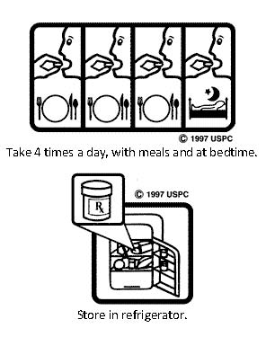
Aids in communication: pictograms

Slide 35
5 steps to improved health literacy
1. Slow your roll! Avoid rapid-fire speech, take your time.
2. Have the patient teach back what you have taught. “How would you teach your sister what I have just taught you?”
3. Encourage questions! Do not just ask “Do you have any questions?”. Perhaps offer a scenario “What would you need to know if you are at a family picnic and were offered a big dessert? How would that affect your blood sugar?” Giving real world scenarios jogs the mind to ask for clarification.
4. Use plain language! “The appropriate treatment for your pulmonary condition is the albuterol metered dose inhaler.” OR “The inhaler the doctor has given you will help your breathing when you feel really tight. Tell me what you know about your inhaler. Would you like to know more?”
5. Use examples, use props, use whatever tools work best for your patient!

